Slide 1
Online Shoppers Intention

Slide 2
Dataset overview:
12,330 Visitor
18 features

Slide 3
Problem:
try improve the customers experience with the website, to gain more revenues

Slide 4
Target:
Revenue

Slide 5
Prepossessing
Null Point
turn catorgical vaalue into numerical

Slide 6
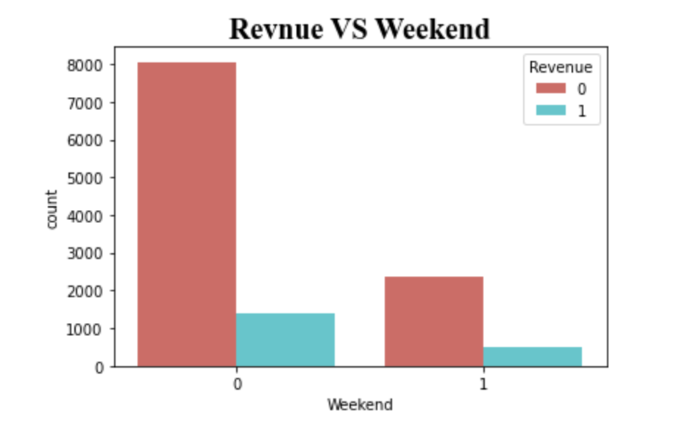
Exploratory Data analysis (EDA)
Is the weekend a factor to raise the revenue?

Slide 7
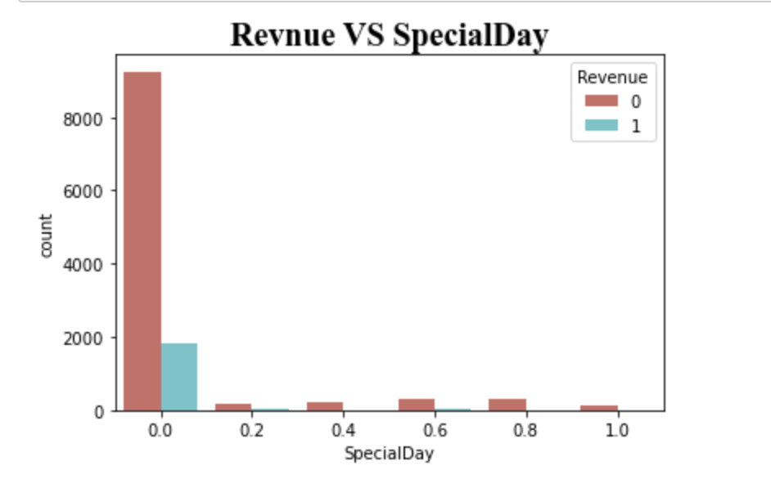
Exploratory Data analysis (EDA)
the closeness of the site visiting time to a specific special day (e.g., Mother’s Day, Valentine's Day) effect the revenue ?

Slide 8
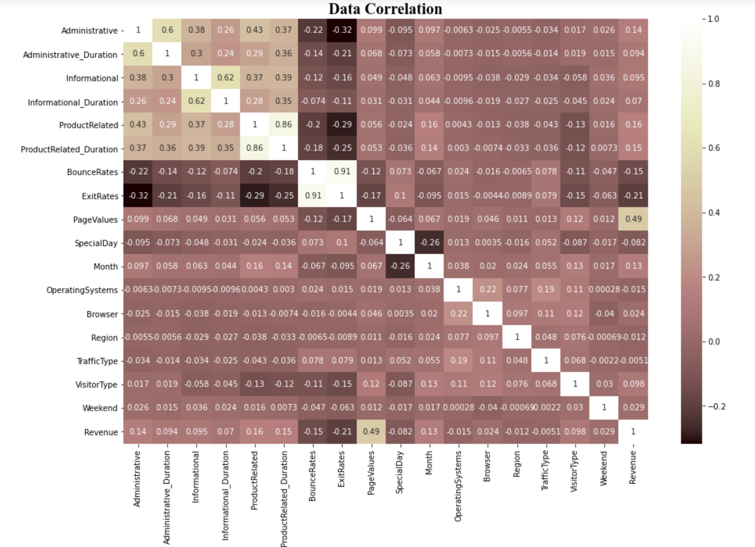
Exploratory Data analysis (EDA)
What features has the strong correlation with revenue?

Slide 9
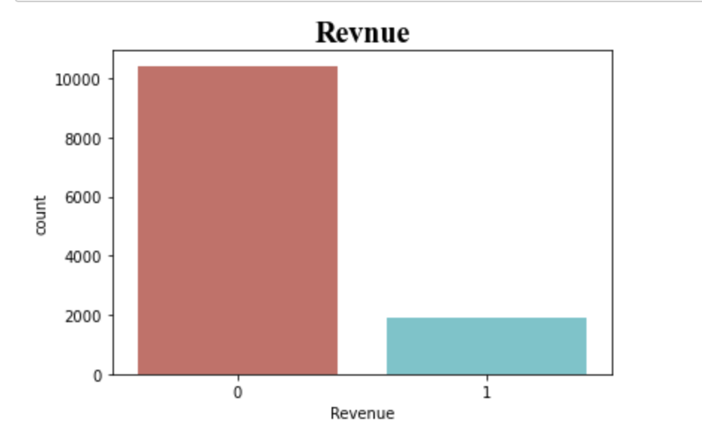
Exploratory Data analysis (EDA)
BUT!!

Slide 10
Model:
Logistic regression
“Support Vector Machine” (SVM)
Without & With oversampling

Slide 11
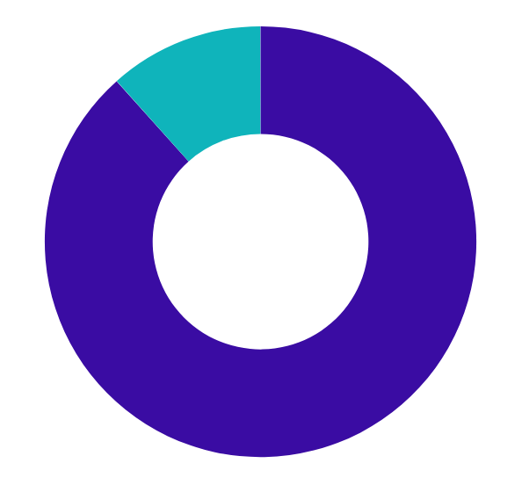
Result:
Logistic regression
Predicted 0s
Predicted 1s
Actual 0s
3063
75
Actual 1s
356
205
88%
Recall= 0.895
precision= 0.976
specifity= 0.732
the accurcy on test set

Slide 12
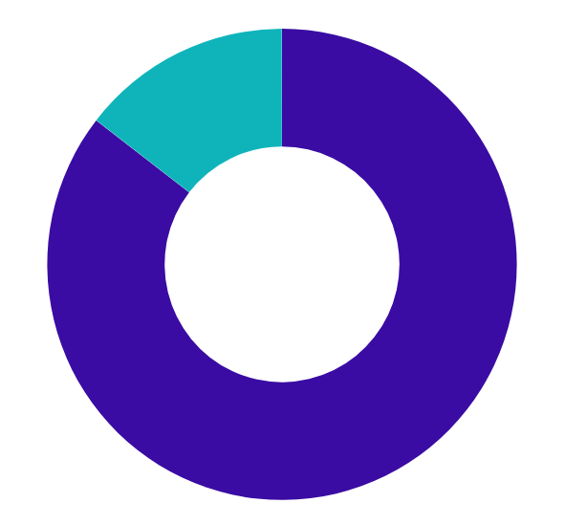
Result:
“Support Vector Machine” (SVM)
Predicted 0s
Predicted 1s
Actual 0s
3138
0
Actual 1s
556
5
88%
the accurcy on test set
Recall= 0.849
precision= 1.0
specifity= 1.0

Slide 13

Result:
Logistic regression
Predicted 0s
Predicted 1s
Actual 0s
2543
73
Actual 1s
1596
999
67%
Recall= 0.614
precision= 0.972
specifity= 0.931
the accurcy on test set

Slide 14
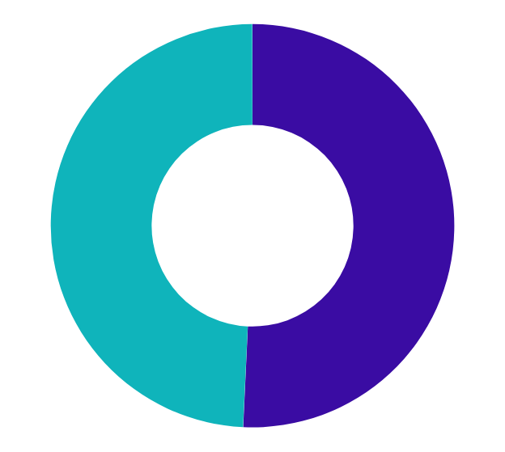
Result:
“Support Vector Machine” (SVM)
Predicted 0s
Predicted 1s
Actual 0s
2616
0
Actual 1s
2565
30
50%
the accurcy on test set
Recall= 0.504
precision= 1.0
specifity= 1.0

Slide 15
Future Work!
use other classficition model
try other ombalnce class method

Slide 16
THANK YOU!

